Slide 1

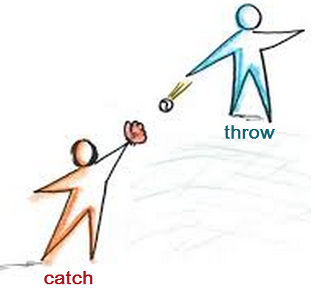
Exception Handling
CMPS 251
Read Chapter 11
Unit 3_02

Slide 2
Outline
Exception handling using try-catch-finally
Exception Types
Throwing an Exception
Custom Exceptions
Notes:
Similarities and differences between Java and C++

Slide 3
try-catch-finally block

Slide 4
Definition
An exception is an event that occurs during the execution of a program that disrupts the normal flow of execution.
Examples
A program is going to read a file, but the file is missing
A program is reading an array, but the out of bound case occurs
A program is receiving a file, but the network connection fails
With exception handling, a program can continue executing (rather than terminating) after dealing with the exception.
Notes:
Mission-critical or business-critical computing.
Exception — an indication of a problem that occurs during a program’s execution.
The name “exception” implies that the problem occurs infrequently.
http://download.oracle.com/javase/tutorial/essential/exceptions/definition.html:
" The term exception is shorthand for the phrase exceptional event.“
Definition: An exception is an event, which occurs during the execution of a program and disrupts the normal flow of the program's instructions.

Slide 5
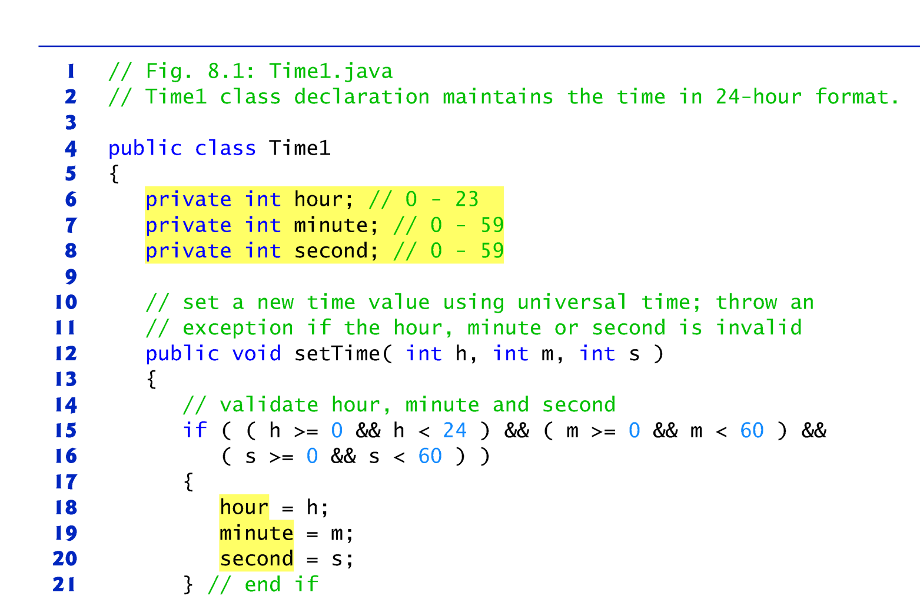
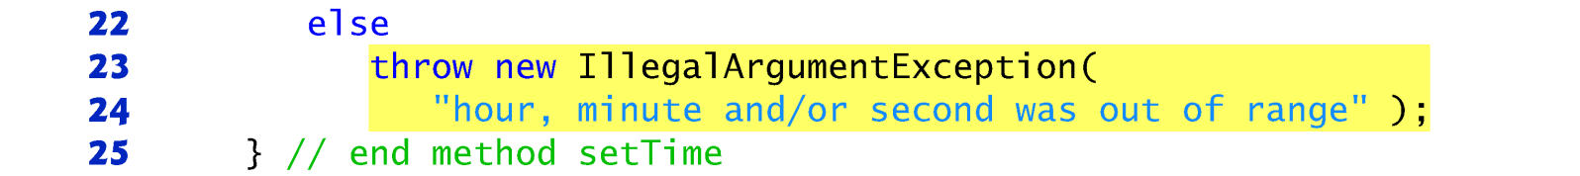

Example of throwing an exception
throws an IllegalArgumentException
if the data validation fails in set method

Slide 6
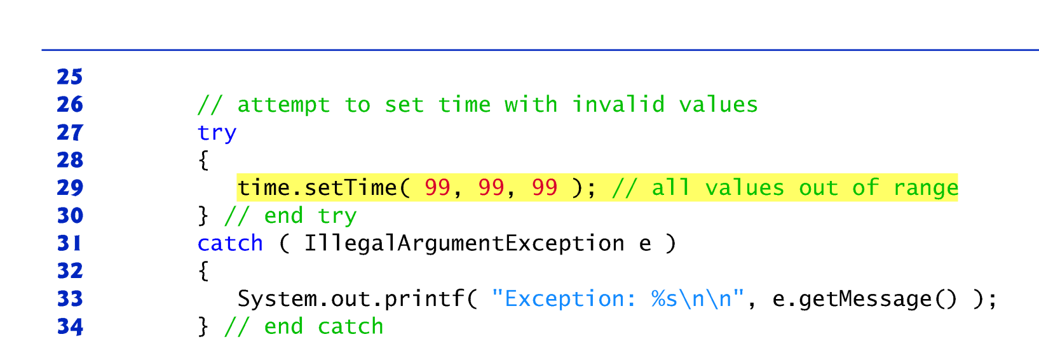
Example of catching and handling the Exception
Catch and handle the Exception

Slide 7
Method setTime() and Exception Handling
For incorrect values, setTime throws an exception of type IllegalArgumentException (lines 23–24)
The throw statement (line 23) creates a new object of type IllegalArgumentException and pass a custom error message
The throw statement immediately terminates setTime() method and the exception is returned to the client code that attempted to set the time
The client can use try...catch to handle the exception
Notes:
Q: Who’s the client of setTime() in this application?

Slide 8
Some common exceptions …
ArrayIndexOutOfBoundsException occurs when an attempt is made to access an element past either end of an array
A NullPointerException occurs when a null reference is used where an object is expected
ClassCastException occurs when an attempt is made to cast an object that does not have an is-a relationship with the type specified in the cast operator.
IOException may occur when reading or writing to files
Notes:
For a list of subclasses of Exception, see http://download.oracle.com/javase/7/docs/api/java/lang/Exception.html
ClassNotFoundException,

Slide 9

Exception Handling using try-catch-finally
try {
//…something might have exception
}
catch (SomeExceptionClass e) {
//handle the exception here
}
finally {
//release resources
//Perform any actions here common to whether or not an exception is thrown.
}
Notes:
Use try blocks to delimit code in which exceptions might occur
Throw exceptions to indicate a problem
Use catch blocks to specify exception handlers
Use the finally block to release resources
Create custom exceptions
try {
Protect one or more statements here.
}
catch(Exception e) {
Report and recover from the exception here.
}
finally {
Perform any actions here common to whether or not an exception is thrown.
}

Slide 10
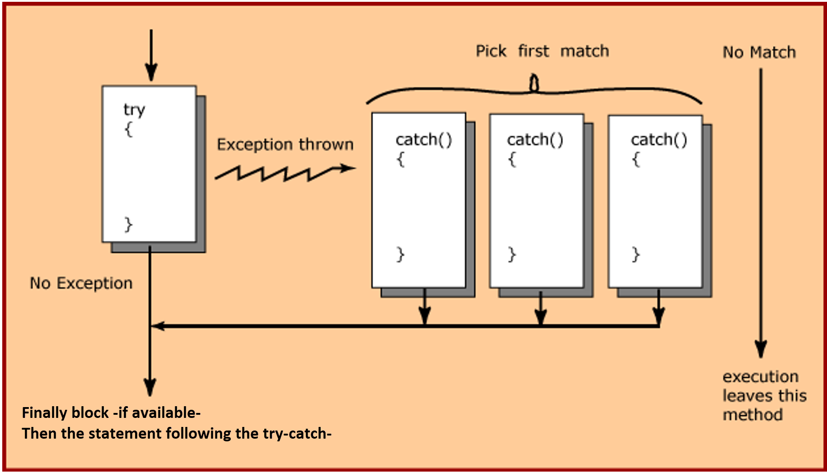
How try and catch Work
Notes:
Use try blocks to delimit code in which exceptions might occur
Throw exceptions to indicate a problem
Use catch blocks to specify exception handlers
Use the finally block to release resources
Create custom exceptions

Slide 11
How try and catch Work (1 of 2)
If an exception occurs in a try block, the try block terminates immediately and program control transfers to the first catch block whose type matches the type of the exception that occurred
If there are remaining statements after the statement that causes the exception, those remaining statements won’t be executed.
After the exception is handled, any remaining catch blocks are ignored, and execution resumes at:
The finally block, if one is present
Or at the first line of code after the try…catch sequence
Control does not return to the try block.
Notes:
This is known as the termination model of exception handling
control resumes at the a finally block, if one is present after the last catch block.
Hence the most specific exception types should appear first in the structure, followed by the more general exception types.
After executing the exception handling statements, the control goes to the first statement that follows the try/catch block.
When an exception occurs in the try{} block, the catch block that executes is the first one whose type matches the type of the exception that occurred.
When a try block terminates, local variables declared in the block go out of scope.
The local variables of a try block are not accessible in the corresponding catch blocks.
When a catch block terminates, local variables declared within the catch block (including the exception parameter) also go out of scope.
c.f., Some languages (not Java) use the resumption model of exception handling, in which, after an exception is handled, control resumes just after the throw point.

Slide 12
How try and catch Work (2 of 2)
If no catch{} block matches the exception, the execution leaves this method
The unhandled exception is passed to the caller
Uncaught exceptions keep propagating all the way to main method. If they are still not handled in the main then the Java runtime will display an error message then terminate the application
If no exception occurs in the try block, the catch blocks are skipped and the execution continues at the finally block, if one is present, then the statement after the try…catch sequence
The finally block , if one is present, will always execute whether or not an exception occurs in the corresponding try block
The finally block is used to release resources acquired in the try block such as closing files and database/network connections
Notes:
If an exception that occurs in a try block cannot be caught by one of that try block’s catch handlers, control proceeds to the finally block.
Then the program passes the exception to the next outer try block—normally in the calling method—where an associated catch block might catch it.
This process can occur through many levels of try blocks.
The exception could go uncaught.
If a catch block throws an exception, the finally block still executes.
Then the exception is passed to the next outer try block—again, normally in the calling method.
When an exception occurs in the try{} block, the catch block that executes is the first one whose type matches the type of the exception that occurred.
Any remaining catch blocks in the try statement are ignored, and execution resumes at the first line of code after the try…catch sequence.
Or a finally block, if one is present.
Hence the most specific exception types should appear first in the structure, followed by the more general exception types.
After executing the exception handling statements, the control goes to the first statement that follows the try/catch block. Control does not return to the try block.
If no catch{} block matches the exception, the execution leaves this method (the unhandled exception is passed to the caller)
the catch{} blocks are examined one-by-one.
The first matching catch{} block is picked to handle the exception.
When an exception occurs in a try block, the catch block that executes is the first one whose type matches the type of the exception that occurred.
Use the System.err (standard error stream) object to output error messages.
By default, displays data to the command prompt.
Can be redirected to a log file for persistent data storage.

Slide 13
When to Use Exceptions?
Use the event is truly exceptional and is an error
Do not use it to deal with simple and expected situations
Example:
try {
System.out.println(refVar.toString());
}
catch (NullPointerException ex) {
System.out.println("refVar is null");
}
Can be replaced by:
if (refVar != null)
System.out.println(refVar.toString());
else
System.out.println("refVar is null");

Slide 14
Try with multiple catch blocks
try {
//maybe read a file or something…
}
catch (FileNotFoundException e) {
System.out.println("FileNotFoundException: " +
e.getMessage());
}
catch (IOException e) {
System.out.println("Caught IOException: " +
e.getMessage());
}
Why we catch FileNotFoundException first, and then IOException?
=> The most specific exception types should appear first in the structure, followed by the more general exception types.
- Otherwise if we place the general exception types first then the catch blocks of specific exception types will never be used
- e.g., if we move catch (IOException e) first then catch (FileNotFoundException e) will never be used.
Exception
IOException
FileNotFoundException
Notes:
throw new SampleException(e);

Slide 15
Superclass/Subclass Exceptions
A catch parameter of an exception can also catch all the exception subtypes
Enables catch to handle related exceptions with a concise notation
E.g., catch (Exception e) can catch all exceptions that are subtypes of Exception class
Catching related exceptions in one catch block makes sense only if the handling behavior is the same for all subclasses
You can also catch each subclass type individually if those exceptions require different processing
If multiple catch blocks match a particular exception type, only the first matching catch block executes.

Slide 16
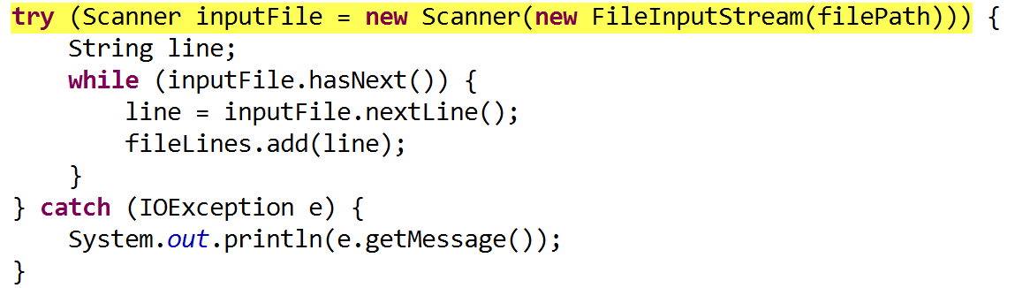
try-with-resources
The try-with-resources is a try statement that declares a resource (i.e., an object that must be closed after the try block)
Any object that implements java.lang.AutoCloseable can be used as a resource.
“try-with-resources” will auto-close the resource (e.g., an open file) that was created in the try
It is an alternative for adding a finally block
inputFile will be closed automatically after try block. No need to add a finally block

Slide 17
Exception Types

Slide 18
2 kinds of exceptions
Checked exception (Java forces you to handle them)
These are exceptional conditions that a well-written application should anticipate and recover from.
They occur usually when interacting with resources e.g. missing files, database connection problems, network connection errors e.g., FilNotFoundException
Unchecked exceptions (Java does NOT force you to handle them), they include:
Error exceptions (that extend Error class): Exceptional conditions that are external to the application and outside its control. The application usually cannot anticipate or recover from them. e.g., Out of memory exception
Runtime exceptions (that extend RuntimeException class) : caused by programming errors, such as accessing a null object, bad casting, accessing an out-of-bounds array, and arithmetic errors.
Notes:
Unchecked exceptions are usually result of bad code in your system.
Divided by zero
Stack overflow
I/O exceptions, such as packet lost
Disk writing error
Out of memory
They are often logic errors that are not recoverable
For example, a NullPointerException is thrown if you access a null object; an IndexOutOfBoundsException is thrown if you access an element in an array outside the bounds of the array.
Java does not mandate you to write code to catch unchecked exceptions.
These are exceptional conditions that are internal to the application, and that the application usually cannot anticipate or recover from.
These usually indicate programming bugs, such as logic errors or improper use of an API (e.g., NullPointerException).

Slide 19
Unchecked vs. Checked Exceptions
Unchecked exception
Java does not mandate you to catch and handle unchecked exceptions
All other exceptions are checked exceptions, meaning that the compiler forces the programmer to catch and handle them.

Slide 20
Throwing an Exception

Slide 21
Declaring, Throwing, and Catching Exceptions
Throw exceptions to indicate a problem
Use catch blocks to specify exception handlers
Notes:
Use the try block to delimit the code in which exceptions might occur

Slide 22
Declaring Exceptions
Specifies the exceptions a method may throw
E.g., public void myMethod() throws IOException
Can declare a comma-separated list of the exceptions that the method will throw if various problems occur
May be thrown by statements in the method’s body or by methods called from the body
Method can throw exceptions listed in its throws clause or their subclasses.
e.g., IOException is a subclass of Exception
Clients of a method with a throws clause are thus informed that the method may throw exceptions
Notes:
Appears after the method’s parameter list and before the method’s body
Declaring Exceptions
Every method must state the types of checked exceptions it might throw. This is known as declaring exceptions.
public void myMethod() throws IOException
public void myMethod() throws IOException, OtherException

Slide 23
Throwing Exceptions
A method can create an exception instance and throw it
public void setRadius(double radius)
throws IllegalArgumentException {
if (radius >= 0)
radius = radius;
else
throw new IllegalArgumentException(
"Radius cannot be negative");
}
A method can throw multiple exceptions
Notes:
This is known as throwing an exception. Here is an example:
You can throw runtime exception
For example IllegalArgumentException is an unchecked exception
Including it in the throws clause is not mandatory.
Not including it in the throws clause means that the method caller does not have to handle it
You can define your own “Throwable class”
Extend java.lang.Throwable, or java.lang.Exception

Slide 24
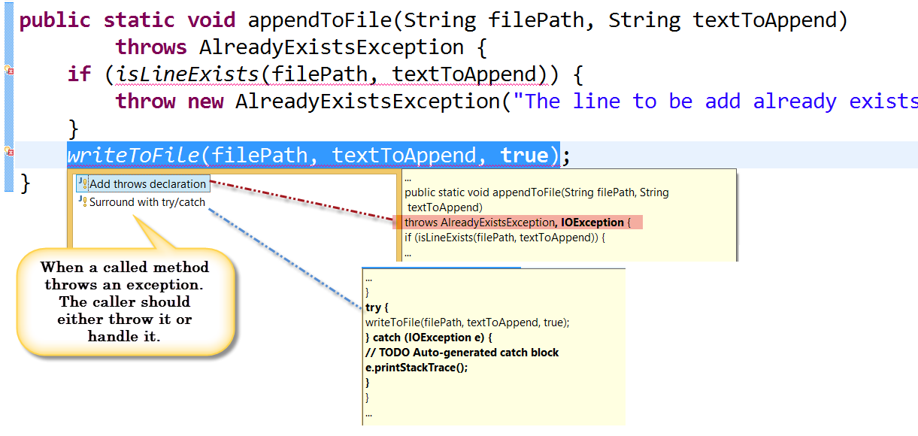
When a called method throws an exception the caller should either throw it or handle it

Slide 25
Custom Exceptions

Slide 26
Creating a New Exception Type
Sometimes it’s useful to create your own exception classes that are specific to the problems that can occur in your app
A new exception class must extend an existing exception class (such as Exception) to be able to use the exception-handling mechanism
Before creating a custom exception try to first use one of Java’s built-in exception classes that might be suitable for the type of problems your methods need to indicate
Notes:
If possible, indicate exceptions from your methods by using existing exception classes, rather than creating new ones. The Java API contains many exception classes that might be suitable for the type ofproblems your methods need to indicate.

Slide 27
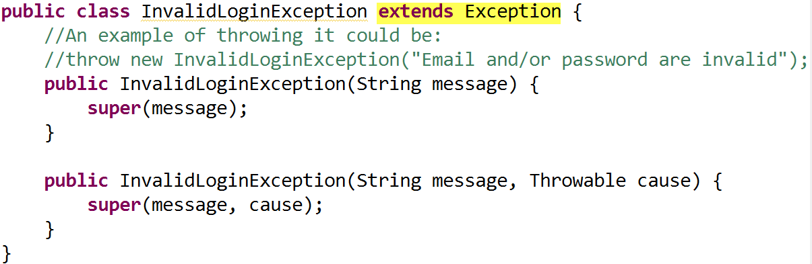
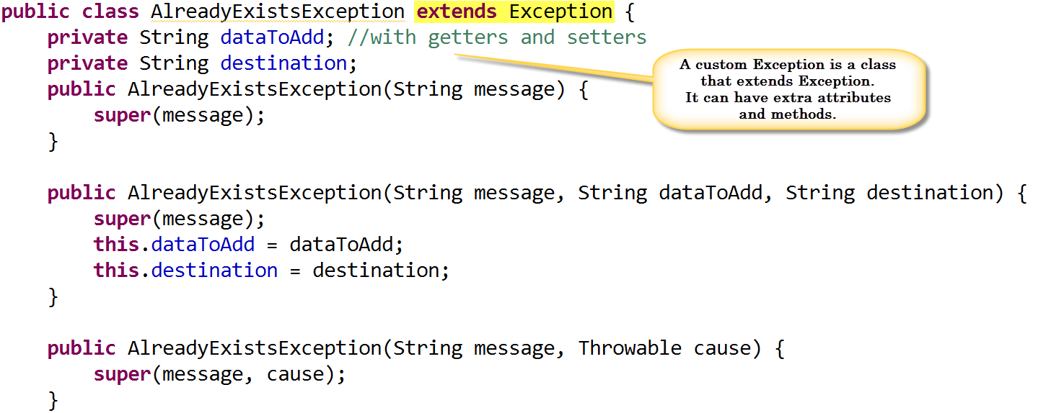
Examples

Slide 28
Summary
Exceptions are a powerful mechanism for separating Error-Handling Code from "Regular" Code => this simplifies the normal flow code
The try block identifies a block of code in which an exception can occur
The catch block defines as an exception handler that can handle a particular type of exception
The finally block is guaranteed to execute, and is the right place to release resources acquired in the try block such as closing files, database connections and network connections
Notes:
Suggestions
If a client can reasonably be expected to recover from an exception, make it a checked exception.
If a client cannot do anything to recover from the exception, make it an unchecked exception.
Summary: Try/Catch Blocks
• finally blocks
try {…
} catch(…) {…
} finally {
…
}
• multicatch
try {…
} catch(Eclass1 | Eclass e) {
…
} …
• try with resources
try (SomeAutoCloseable var = …) {…
} catch(…) { …
} …

